Slide 1
Intro of Out-of-distribution Generalization
Dinghuai Zhang

Slide 2
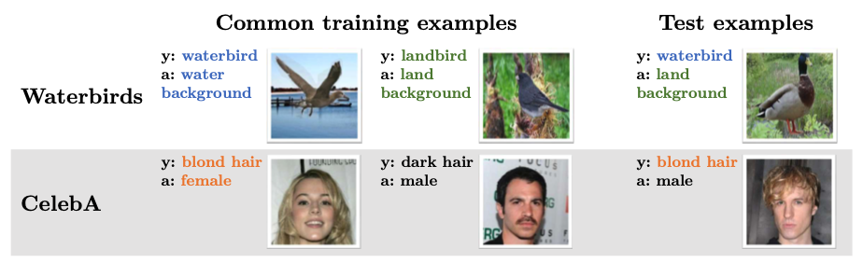
What’s “spurious” correlation?
“true label” and “spurious label”

Slide 3
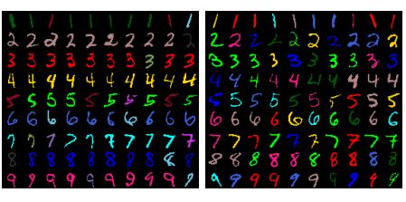
What’s “spurious” correlation?
“true label” and “spurious label”

Slide 4
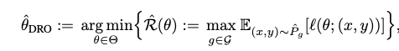
GroupDRO
DISTRIBUTIONALLY ROBUST NEURAL NETWORKS FOR GROUP SHIFTS: ON THE IMPORTANCE OF REGULARIZATION FOR WORST-CASE GENERALIZATION, Shiori Sagawa et al. ICLR2020

Slide 5
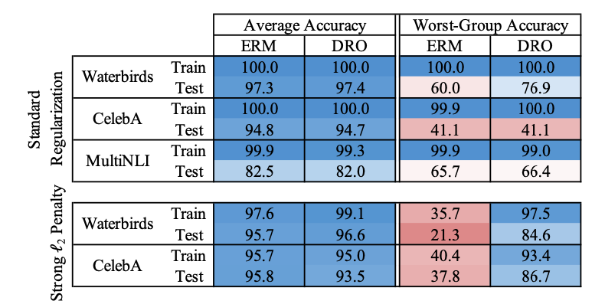

Slide 6
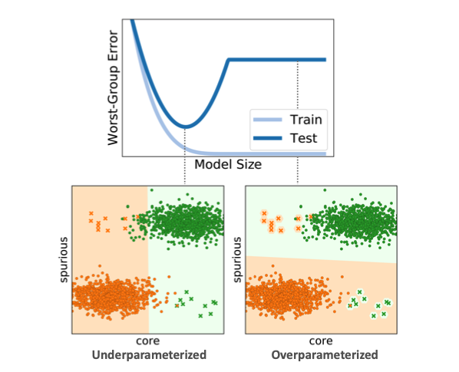
Overparameterization exacerbates spurious correlations
As model size grows, avg errors decrease,
but worst group error increases
Reason: overparametrized models use
spurious feature to classify
An investigation of why overparameterization exacerbates spurious correlations, Shiori Sagawa et al. ICML2020

Slide 7
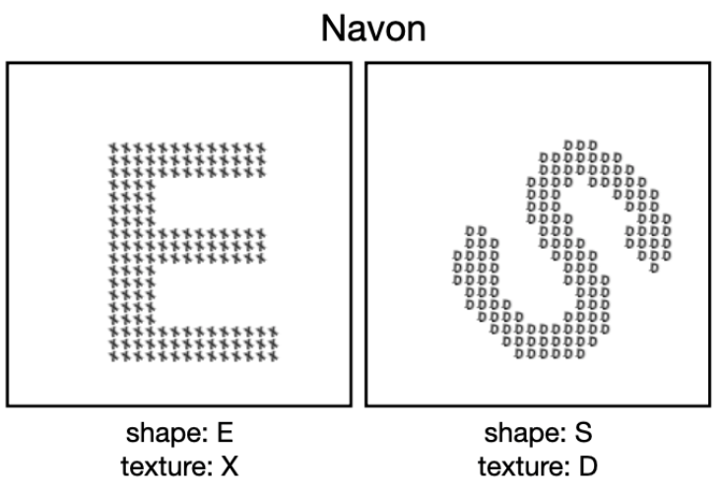
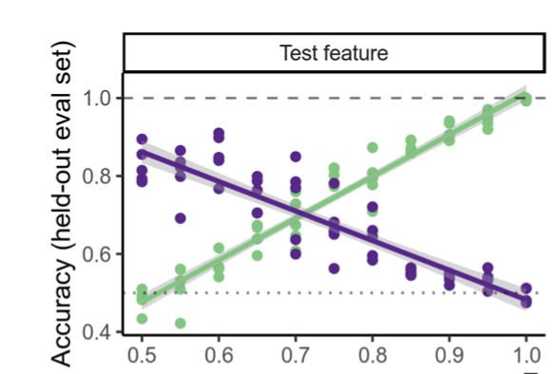
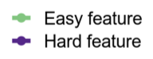
Another name: Simplicity Bias
What shapes feature representations? Exploring datasets, architectures, and training. NeurIPS2020.

Slide 8
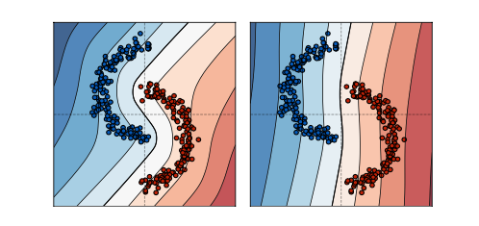
Gradient Starvation
“overfitting” property of ERM
Gradient Starvation: A Learning Proclivity in Neural Networks Mohammad Pezeshki et al.

Slide 9
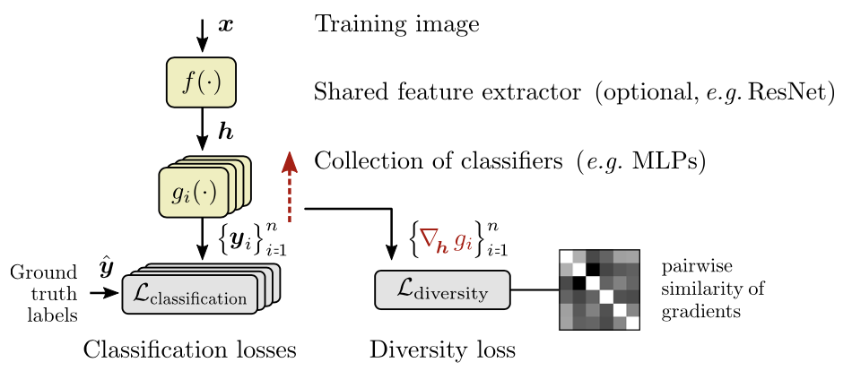
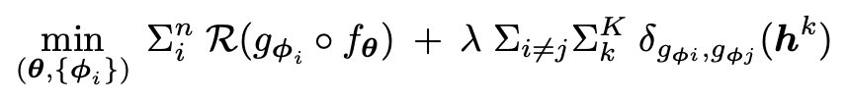
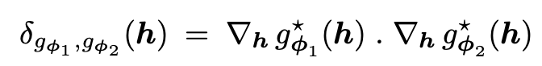
Solution: Promote Diversity
Train multiple classifiers:
With post model selection method
Evading the Simplicity Bias: Training a Diverse Set of Models Discovers Solutions with Superior OOD Generalization

Slide 10
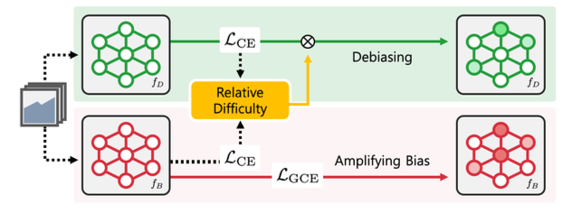
Learning from Failure
Setting: eg. No multiple domains
99% data: label & color has 1 to 1 corresponding
1% data: label & color has no corresponding
Learning from Failure: Training Debiased Classifier from Biased Classifier Junhyun Nam et al., NeurIPS2020

Slide 11
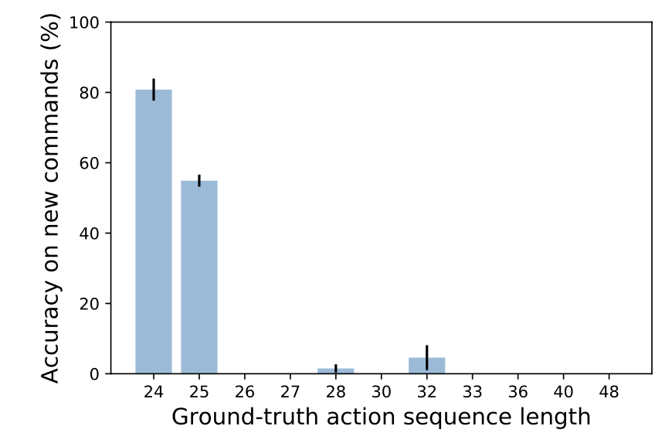
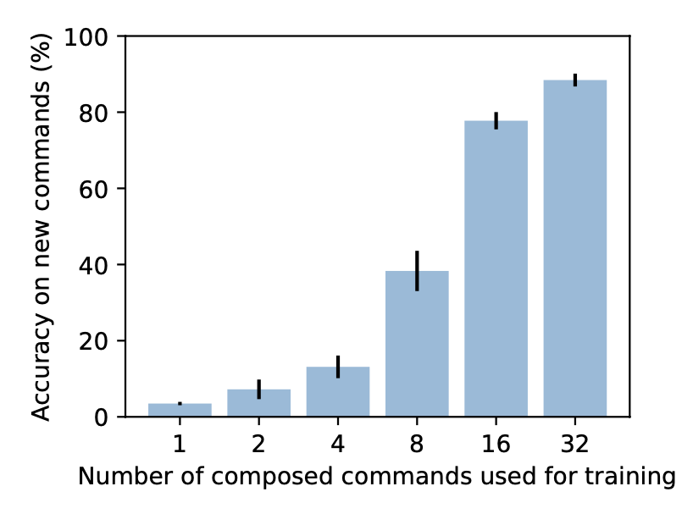
NLP & CogSci: Compositionality
How RNN generalize systematically under distribution shift
Different sequence length
Different word combination methods
Generalization without Systematicity: On the Compositional Skills of Sequence-to-Sequence Recurrent Networks. ICML2018

Slide 12
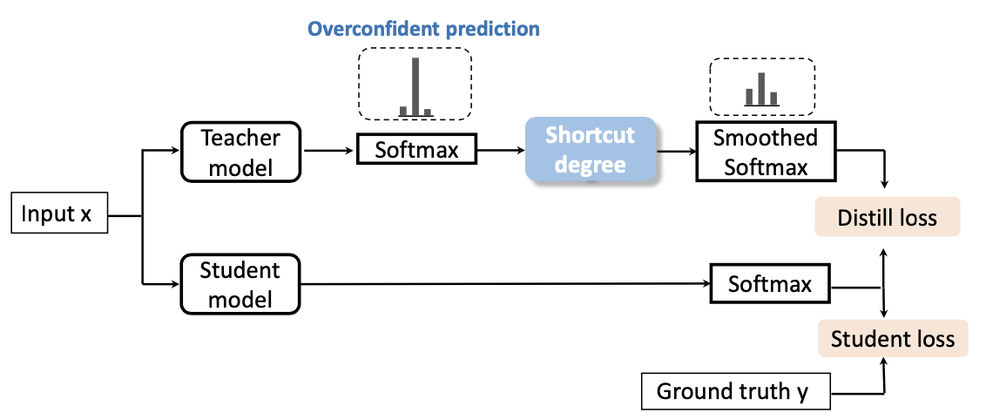
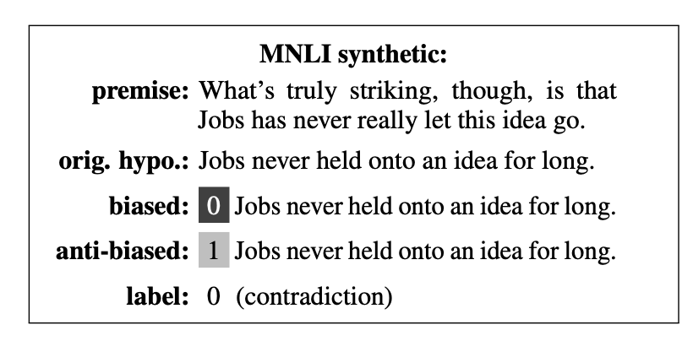
NLP: Debias
Towards Interpreting and Mitigating Shortcut Learning Behavior of NLU models, NAACL2021

Slide 13
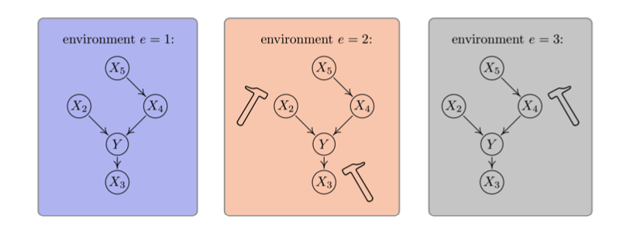
How to get rid of “spurious” feature? Or, how to do invariant learning
Causal inference using invariant prediction: identification and confidence intervals. Jonas Peters et al. JRSSB

Slide 14
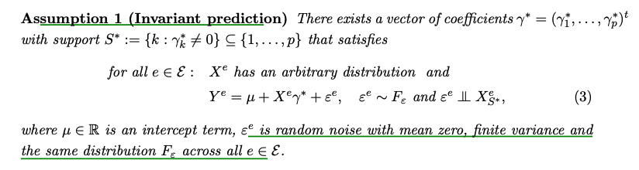
Invariant Causal Prediction (ICP)
We will interchangeably use “domain” and “environment”.

Slide 15
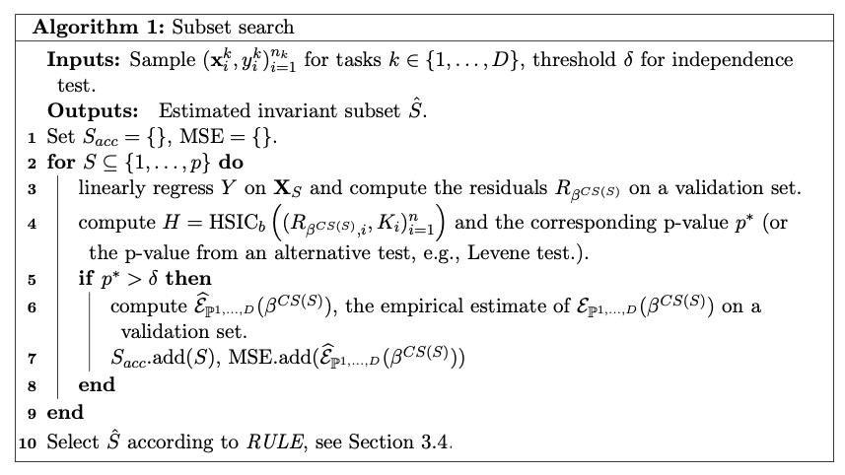
Causal Transfer Learning
Invariant Models for Causal Transfer Learning Mateo Rojas-Carulla et al

Slide 16
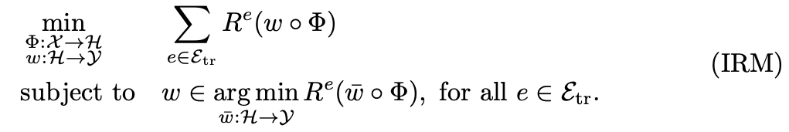
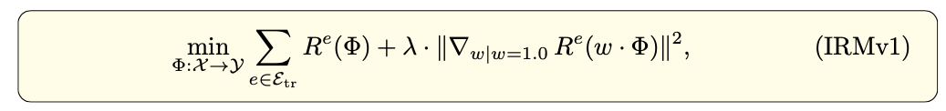
Invariant Risk Minimization
Require the classifier to be simultaneously optimal for all environments!

Slide 17
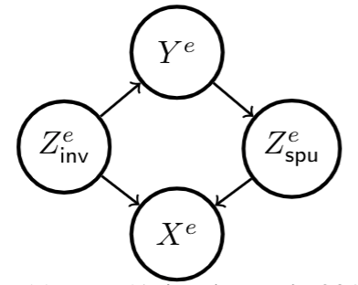
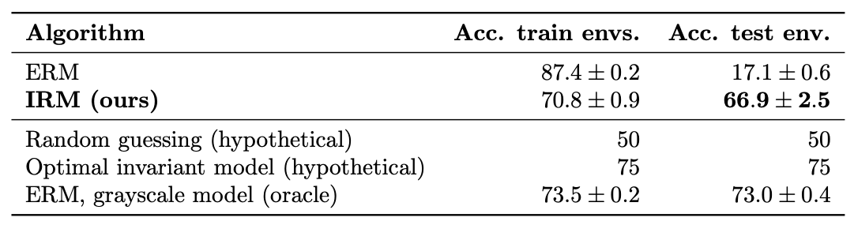
ColoredMNIST
Binary classification: 0~4 as positive class, 5~9 as negative class
Each image is either red or green
Domain1 (train): In all positive images, 70% are red; in all negative images, 30% are red.
Domain2 (train): In all positive images, 80% are red; in all negative images, 20% are red.
Domain3 (test): In all positive images, 10% are red; in all negative images, 90% are red.
Correlation between shape & label is 75% (because 25% label noise)

Slide 18
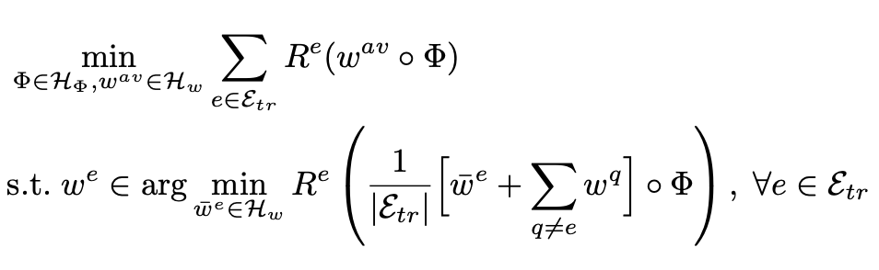
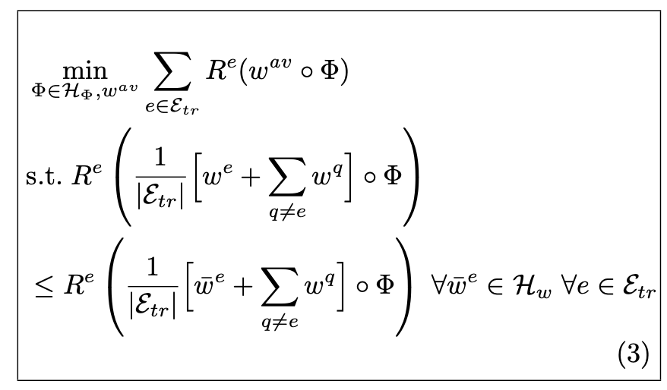
Game theory formulation
A game between many classifiers
IRM Games. ICML2020

Slide 19
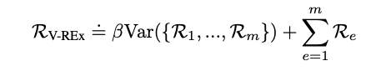
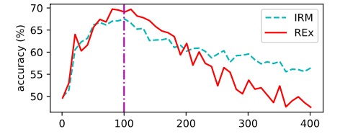
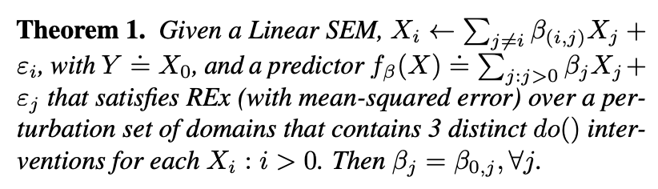
REx
Feature selection effects
Out-of-Distribution Generalization via Risk Extrapolation (REx), David Krueger et al. ICML2021 oral

Slide 20
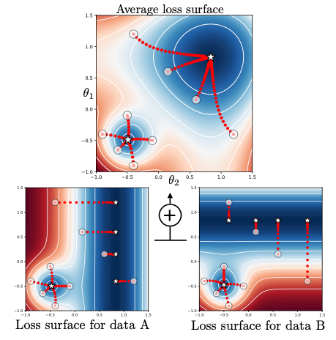
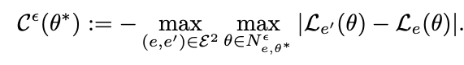
Learning explanations that are hard to vary
Find the solution where the local geometry is invariant
(2 order information)
Learning explanations that are hard to vary Giambattista Parascandolo et al. ICLR2021

Slide 21
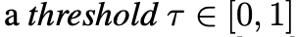
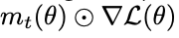
“and mask”

Slide 22
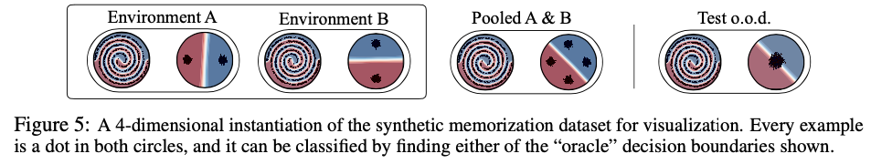
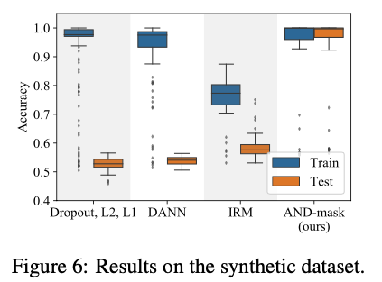

Slide 23
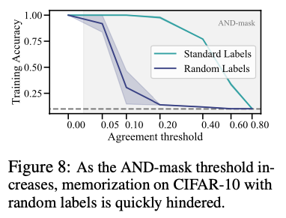
CIFAR10 random label

Slide 24
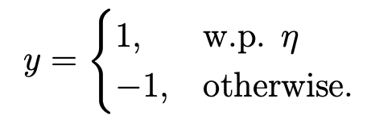
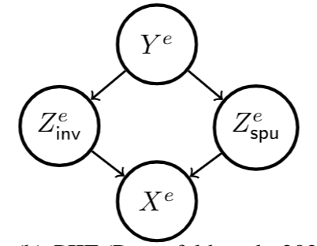
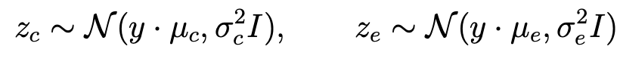
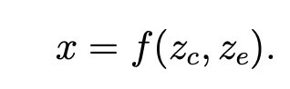
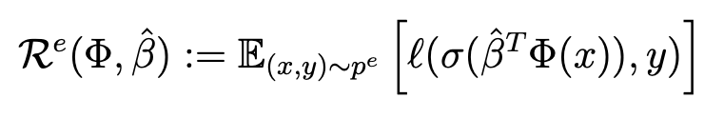
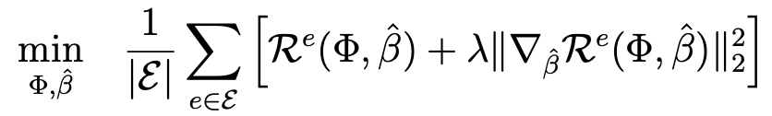
Risks of IRM
Risks of IRM, ICLR2021

Slide 25
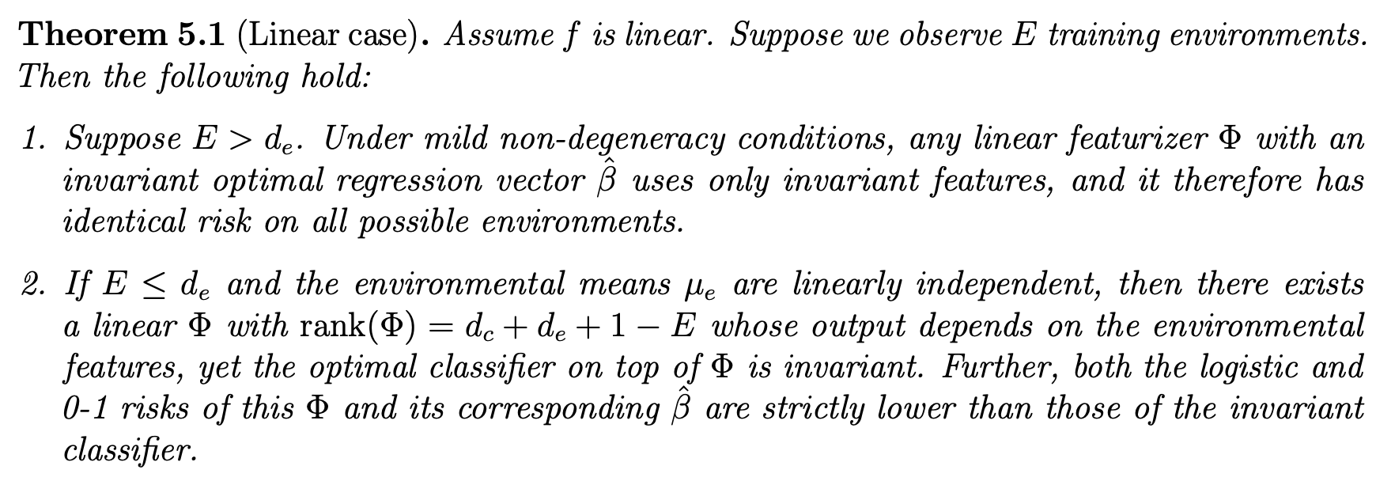

Slide 26
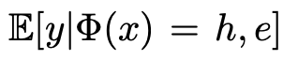
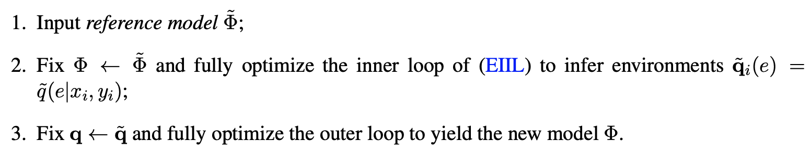
Equivalence to fairness
Env index can be seen as sensitive attributes
Settings without domain label:
Exchanging Lessons Between Algorithmic Fairness and Domain Generalization, Elliot Creager et al.

Slide 27
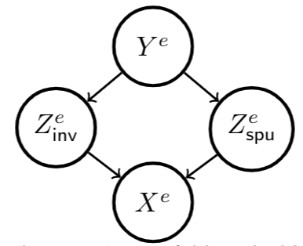
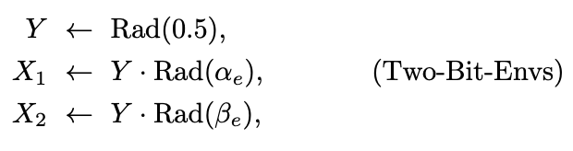
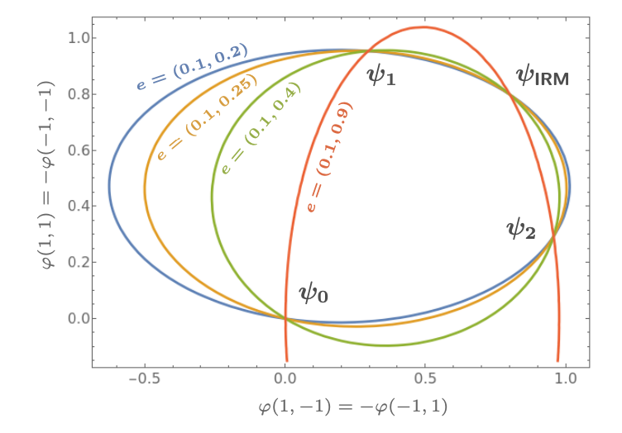
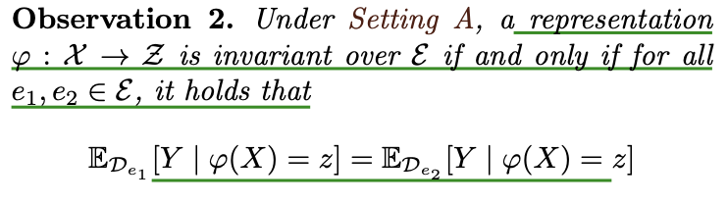
Does IRM Capture Invariance?
Does Invariant Risk Minimization Capture Invariance? AISTATS2021 oral

Slide 28
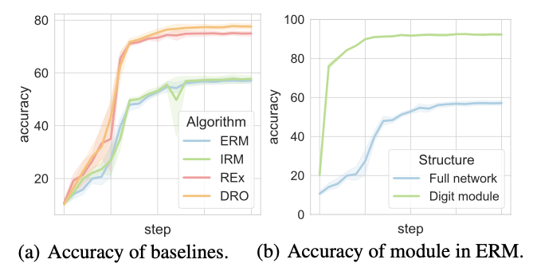

Invariant subnetwork property
Invariant subnetwork exists in normally trained large network:
Design algorithm to utilize this property:
Can Subnetwork Structure Be the Key to Out-of-Distribution Generalization? ICML2021

Slide 29



Information bottleneck (IB) principle
Invariance principle meets information bottleneck for out-of-distribution generalization. Submitted.

Slide 30
More papers at https://sites.google.com/site/irinarish/ood_generalization
Thank you very much!

